Slide 1
Software Design

Slide 2
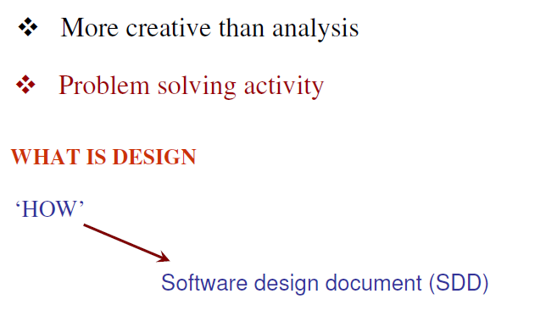

Slide 3
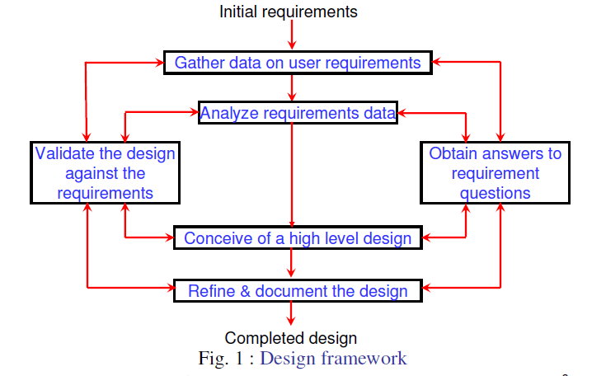

Slide 4
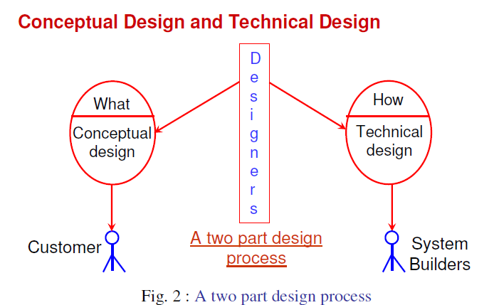

Slide 5
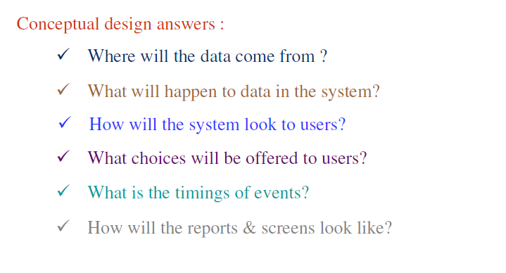

Slide 6
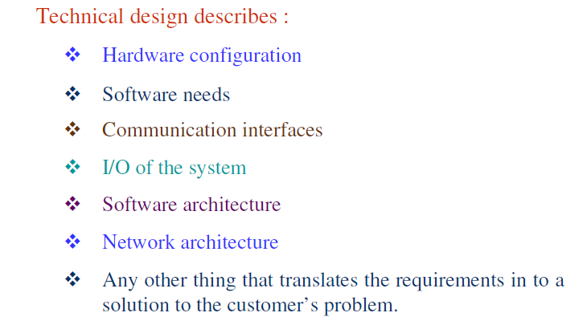

Slide 7
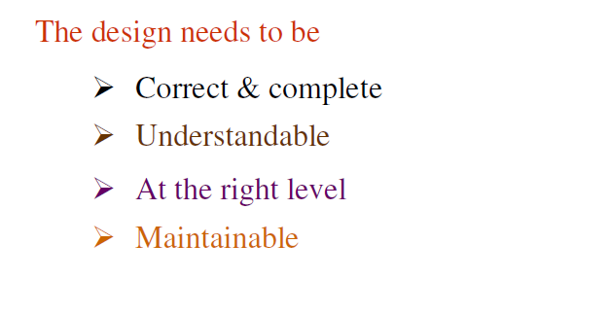

Slide 8
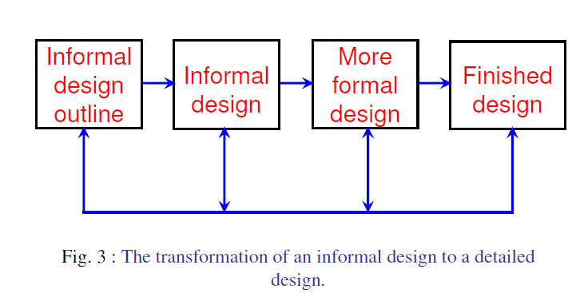

Slide 9
Why is Design important?
Following are the desirable properties of a good design:
Durability
Utility
Charm
Without design, we risk building an unstable system:
One that will fail when small changes are made
One that is difficult to maintain
One whose quality cannot be assessed until late in the software process.

Slide 10
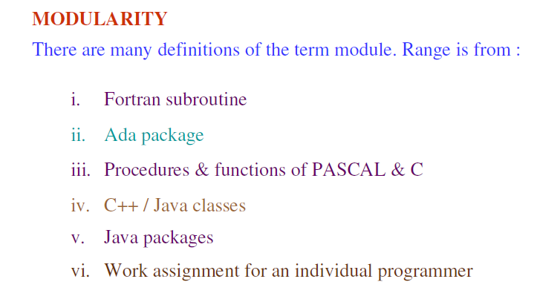

Slide 11
Davis suggests a set of principles for software design:(from Roger Pressman)
The design process should not suffer from “tunnel vision”
The design should be traceable to the analysis model
The design should not reinvent the wheel
The design should “minimize the intellectual distance” between the software and the problem as it exists in the real world.
The design should exhibit uniformity and integration

Slide 12
The design should be structured to accommodate change
The design should be structured to degrade gently, when aberrant data, events, or operating conditions are encountered
Design is not coding, coding is not design
The design should be assessed for quality as it is being created, not after the fact
The design should be reviewed to minimize conceptual(semantic) errors

Slide 13
Desirable properties of a good design include:
Each module is a well defined subsystem that is potentially useful in other applications
Each module has a single, well defined purpose
Modules can be separately combined and stored in a library
Modules can use other modules
Modules should be easier to use than to build
Modules should be simpler from the outside than from the inside.

Slide 14
Modularity is the single attribute of software that allows a program to be intellectually manageable.
A system is considered to be modular if it consists of discreet components so that each component can be implemented separately and a change to one component has minimal impact on other components.
It enhances design clarity, which in turn eases implementation, debugging, documenting and maintenance of the software product.

Slide 15
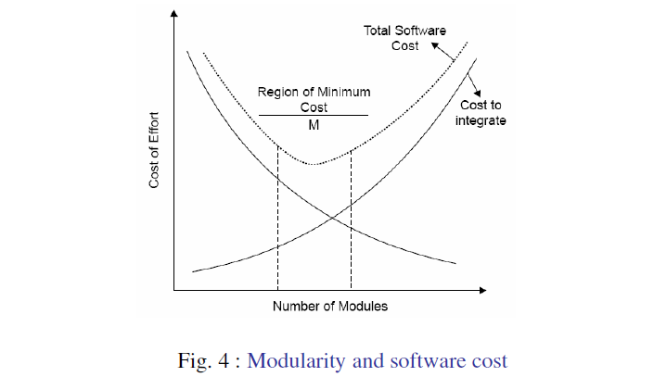

Slide 16
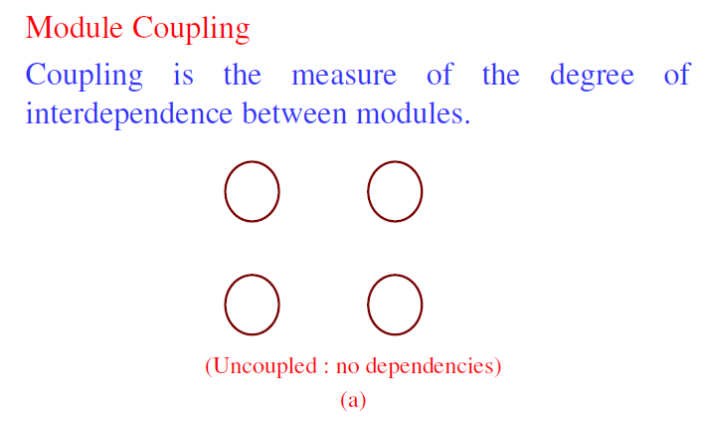

Slide 17
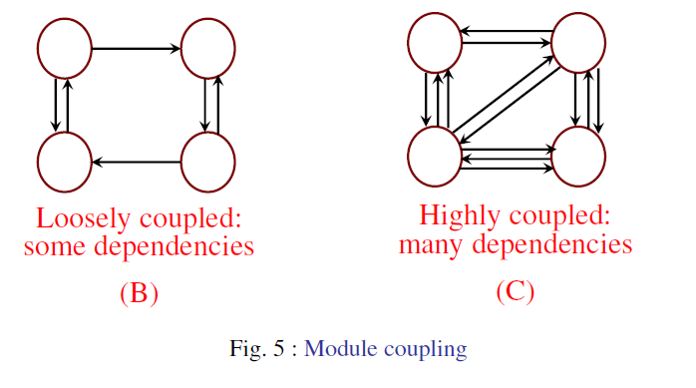

Slide 18
The hypothesis is that design with high coupling will have more errors.
Thus, loose coupling can be achieved in the following ways:
Controlling the number of parameters passed among modules
Avoid passing undesired data to calling module
Maintain parent/child relationship between calling and called modules
Pass data, not control information

Slide 19
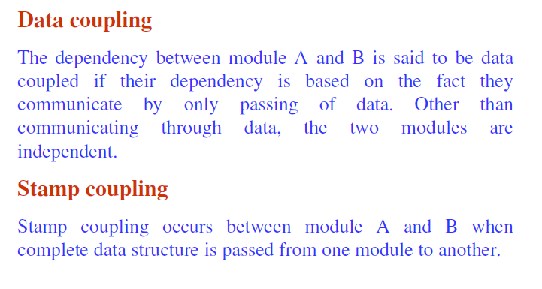

Slide 20
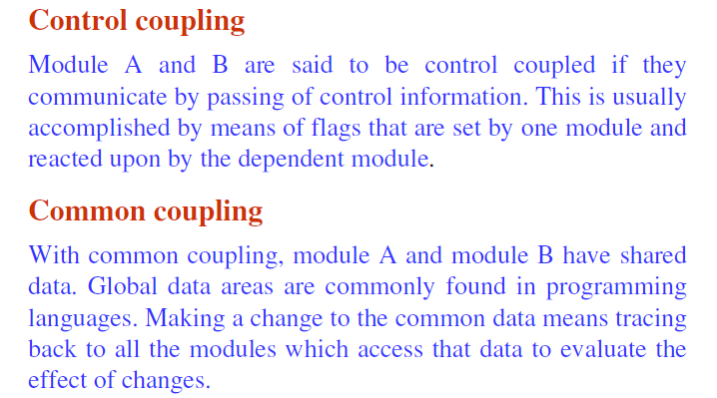

Slide 21
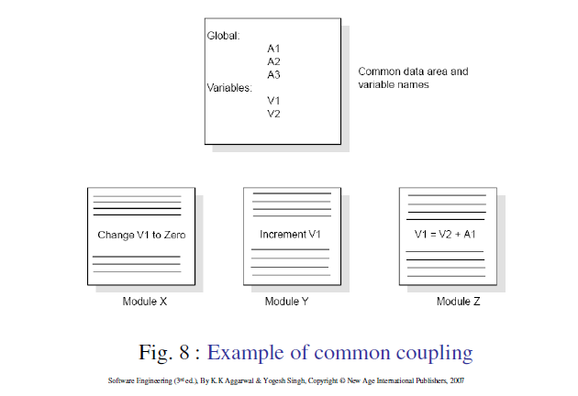

Slide 22
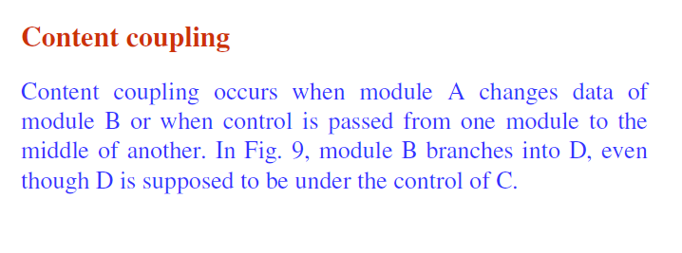
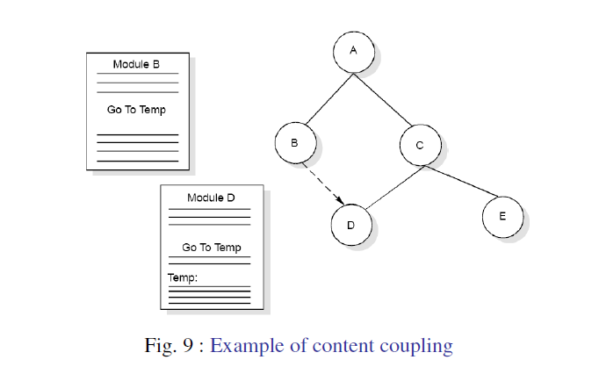

Slide 23
External Coupling:
A form of coupling in which a module has a dependency to other module, external to the software being developed or to a particular type of hardware.
Data coupling
Stamp Coupling
Control Coupling
External coupling
Common Coupling
Content Coupling
Best
Worst

Slide 24
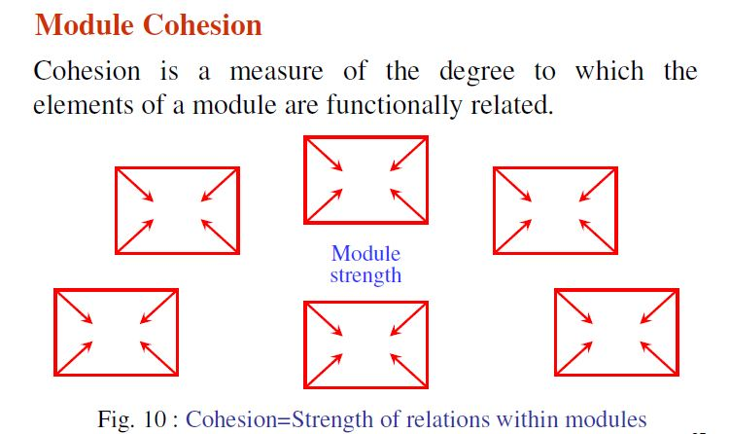

Slide 25
A strong cohesive module implements functionality that is related to one feature of the solution and requires little or no interaction with other modules.
Cohesion may be viewed as a glue that the module together.
Thus, we want to maximize the interaction within a module. Hence, an important design objective is to maximize the module cohesion and minimize module coupling.
High cohesion is associated with several undesirable traits of software including robustness, reliability, reusability and understandability.
Low cohesion is associated with undesirable traits such as being difficult to maintain, test, reuse, or even understand.

Slide 26
Types of Cohesion:
Functional Cohesion
Functional cohesion is when parts of a module are grouped because they all contribute to a well-defined task of the module.
Example:- Mathematical subroutines such as ‘Calculate current GPA’ or ‘Cumulative GPA’.
Sequential Cohesion
Sequential cohesion is when parts of a module are grouped because the output from one part is the input to another part.
Example:- Addition of marks of individual subjects into a specified format is used to calculate the GPA as input for preparing the result of the students.

Slide 27
3. Communicational Cohesion
Communicational cohesion is when parts of a module are grouped because they operate on the same data.
Example:- A module which operates on the same record of information.
Procedural Cohesion
Procedural cohesion is when parts of a module are grouped because they always follow a certain sequence of execution.
Example:- A function which checks file permissions and then opens the file.

Slide 28
5. Temporal Cohesion
Temporal cohesion is when parts of a module are grouped by when they are processed- the parts are processed at a particular time in program execution.
Example:- Example:- The set of functions responsible for initializations, start up activities such as setting program counters or control flags associated with programs exhibit temporal cohesion.
6. Logical Cohesion
Logical cohesion is when parts of a module are grouped because they are logically categorized to do the same thing even though they are different by nature.
Example:- Grouping all mouse and keyboard input handling routines.

Slide 29
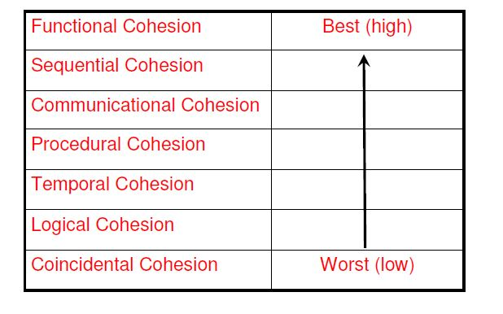
7. Coincidental Cohesion
Coincidental cohesion is when parts of a module are grouped arbitrarily; the only relationship between the parts is that they have been grouped together. There is no conceptual relationship other than shared code.
Example:- “Check validity” and “print” is a single component with two parts.

Slide 30
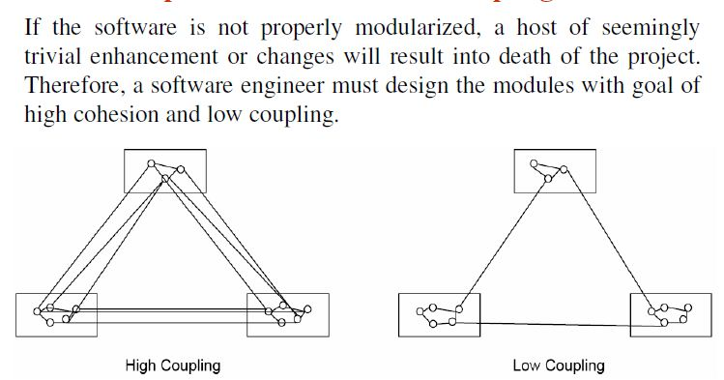
Relationship between Cohesion and Coupling
Notes:
A good example of a system that has high cohesion and low coupling is the “plug and play” feature of the computer system. Various slots in the mother board of the system simply facilitate to add or remove the various services or functionalities without affecting the entire system.

Slide 31

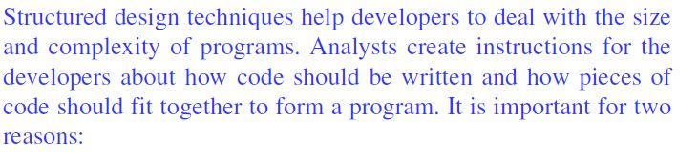
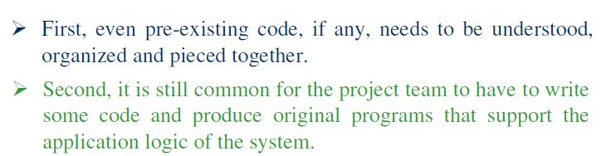
Strategy of Design
R
r

Slide 32
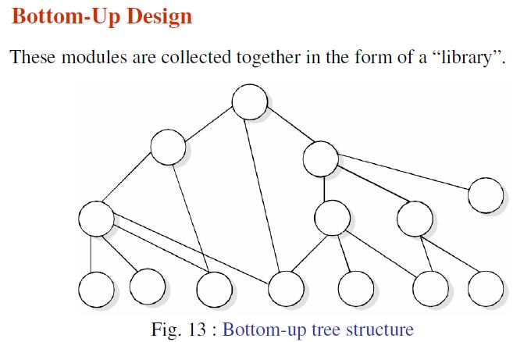
There are many strategies or techniques for performing system design.
They include:-1. Bottom-up design
2. Top down Approach
3. Hybrid Approach
s

Slide 33
This approach lead to a style of design where we decide how to combine these modules to provide larger ones; to combine those to provide even larger ones, and so on, till we arrive at one big module which is the whole of the desired program.
The main argument for this design is that if we start coding a module soon after the design, the chances of recoding is high; but the coded module can be tested and design can be validated sooner than a module whose sub modules have not yet been designed.

Slide 34
This method has one terrible weakness; we need to provide lot of intuition to decide exactly what functionality a module should provide.
If we get it wrong, then at higher level, we will find that is not as per requirements; then we have to redesign at a lower level.
If a system is to be built from an existing system, this approach is more suitable, as it starts from some existing modules.

Slide 35
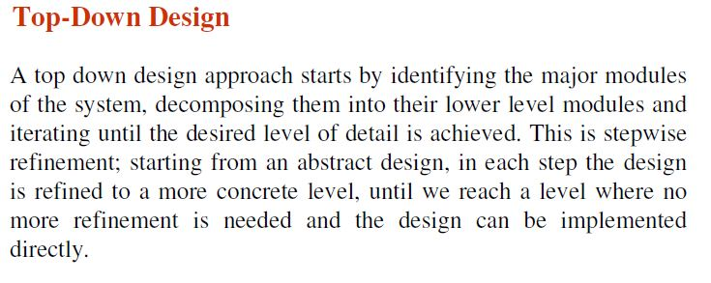
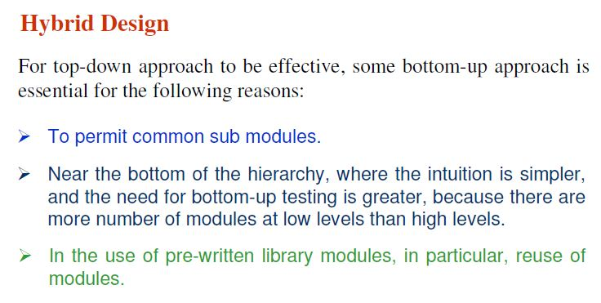
R
s

Slide 36
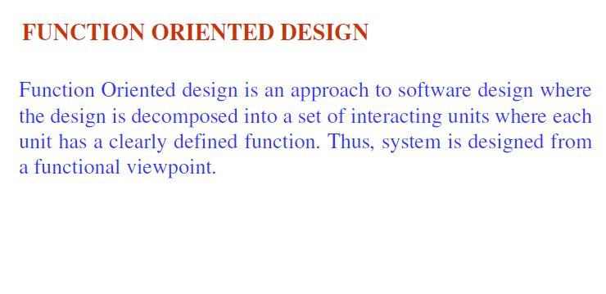
Stepwise refinement is a top-down design strategy originally proposed by Niklaus Wirth.
A program is developed by successively refining levels of procedural detail.

Slide 37
An example of a top down approach to software development:
System: Multiple programs working together in order to achieve a common goal. Eg. Google Drive
Program: An individual piece of software that has been developed for a specific purpose. Eg. Word processor
Module: Stand alone parts within a piece of software used for achieving tasks. Eg. Mail Merge
Subprogram: A sequence of steps that achieve an objective, which Is part of a larger program. Eg. Recording and recalling variable.

Slide 38
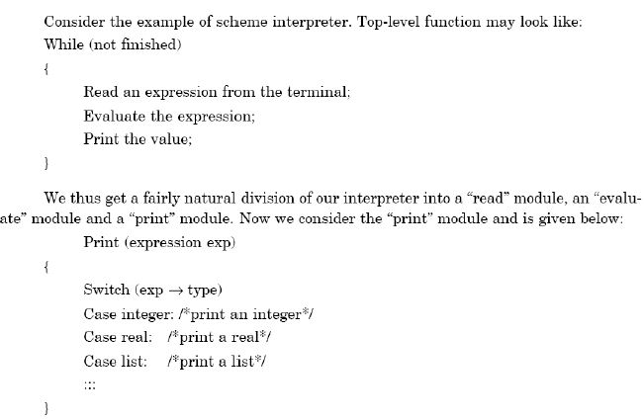

Slide 39
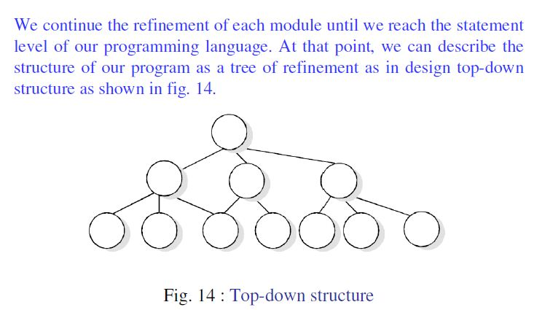

Slide 40
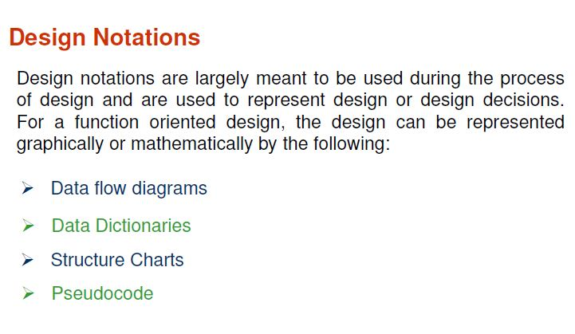

Slide 41
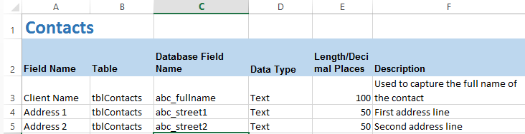
Data Dictionaries: A data dictionary is a collection of descriptions of the data objects or items in a data model for the benefit of programmers and others who need to refer to them.

Slide 42
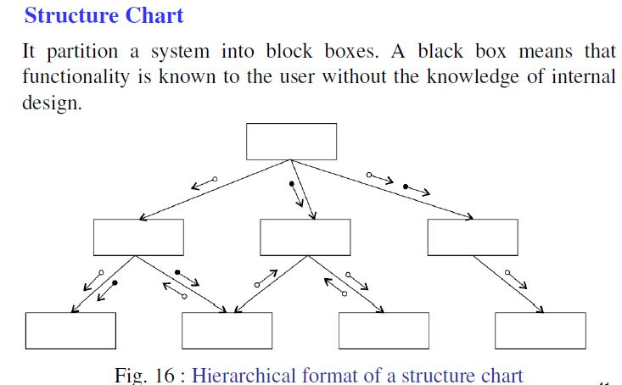

Slide 43
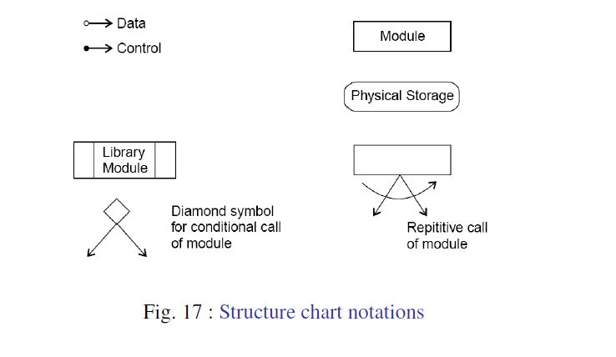

Slide 44
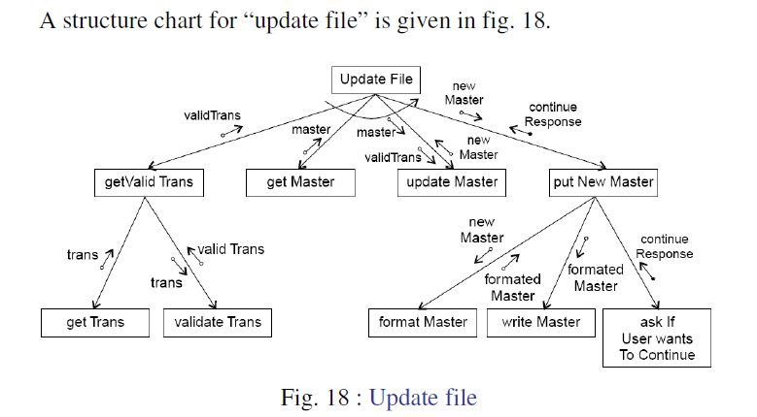
Notes:
*Transform-center structure charts:

Slide 45
Fig 18 represents a transform-centered structures.
Transformed-centered structure chart receives an input which is transformed by a sequence of operations, with each operation being carried out by one module.

Slide 46
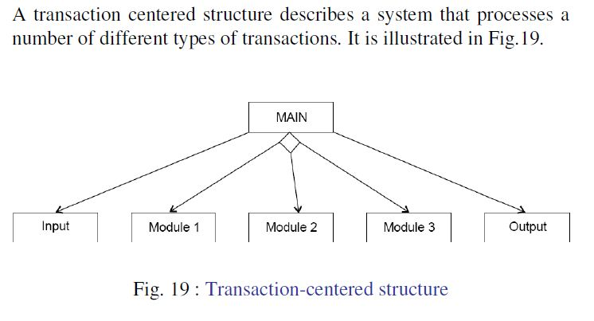
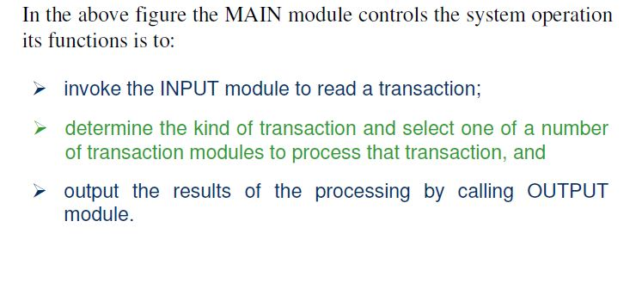

Slide 47
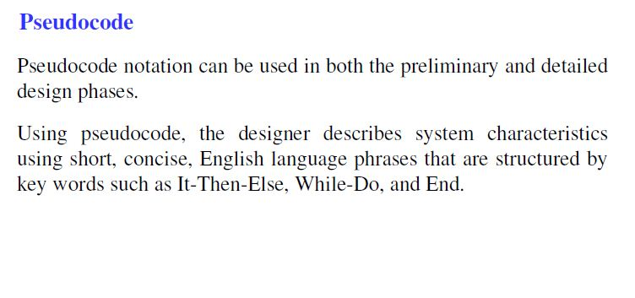

Slide 48
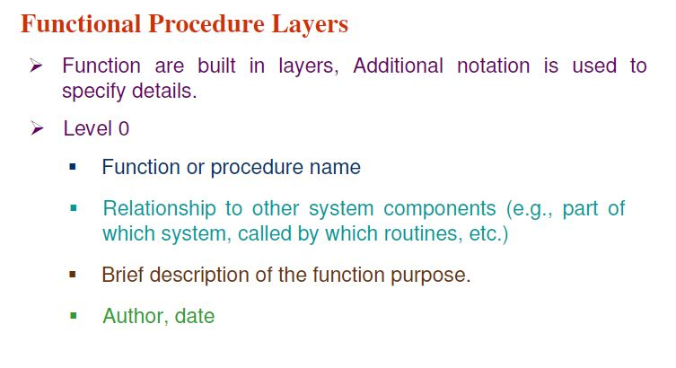

Slide 49
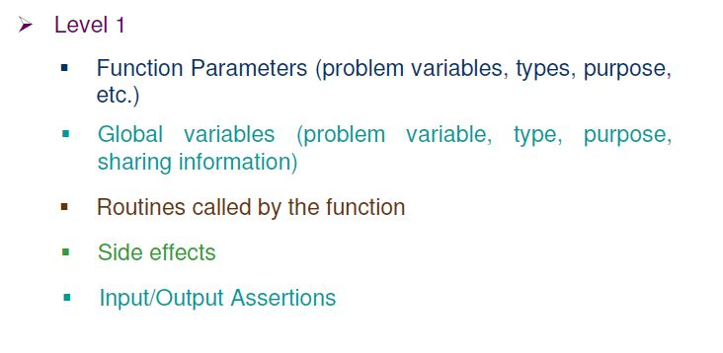

Slide 50
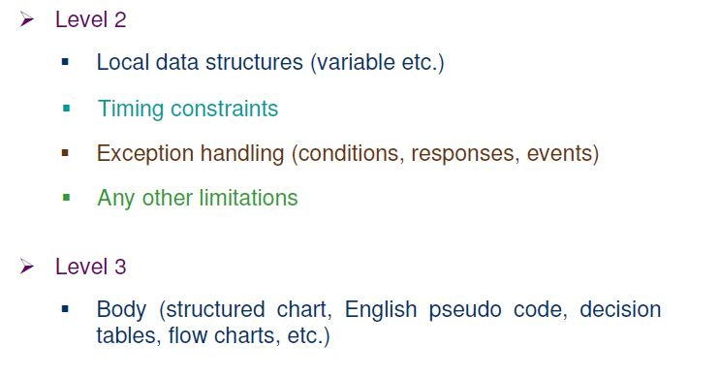

Slide 51
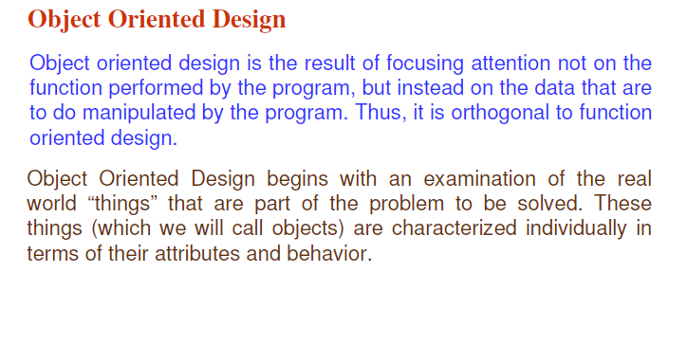
Notes:
The Unified Modeling Language (UML) is a general-purpose, developmental, modeling language in the field of software engineering, that is intended to provide a standard way to visualize the design of a system.
UML Diagram types:
Structural:-Class diagrams
Behavioral diagrams:- Use Case, Activity diagram, State Diagram and The sequence diagrams

Slide 52
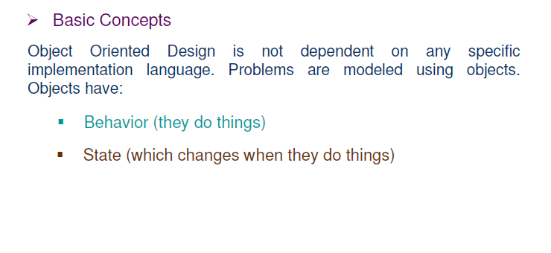
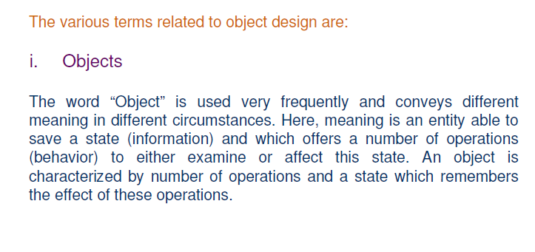

Slide 53
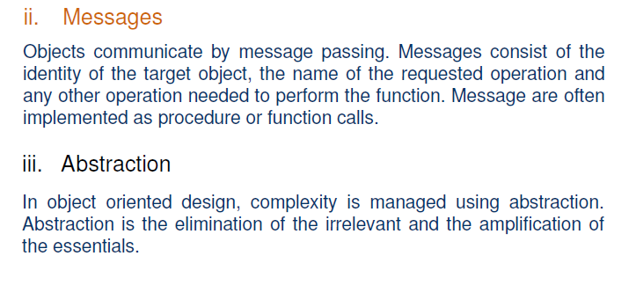

Slide 54
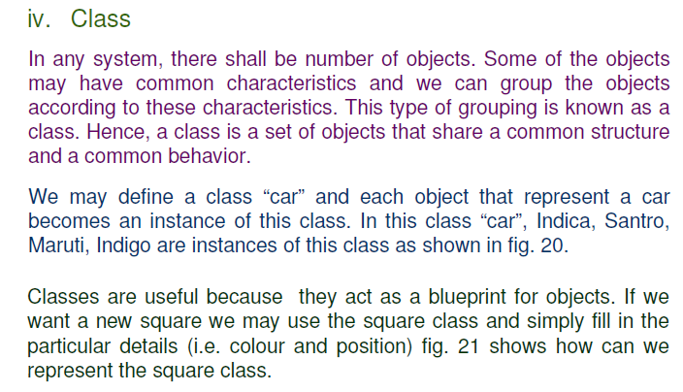

Slide 55
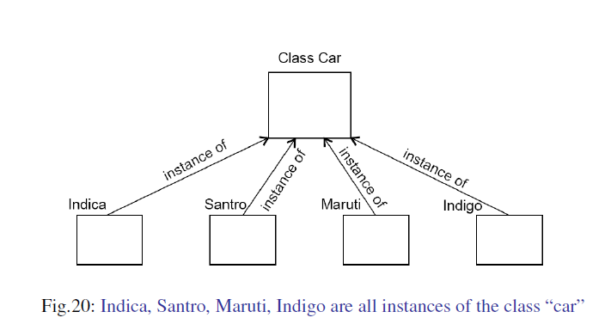

Slide 56
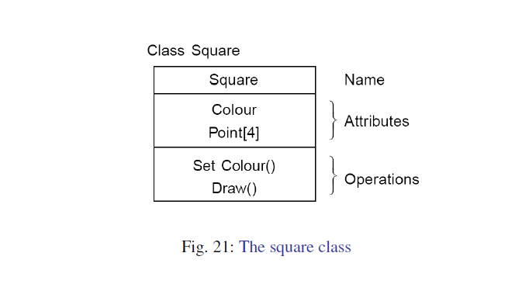

Slide 57
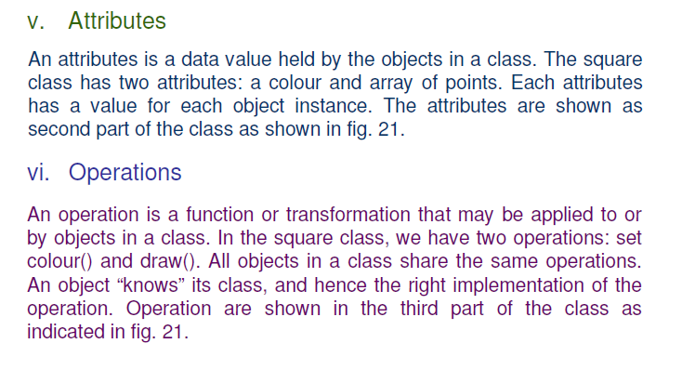

Slide 58
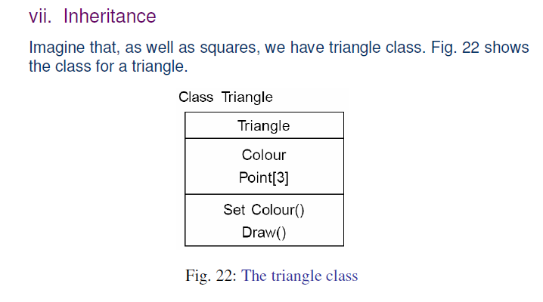

Slide 59
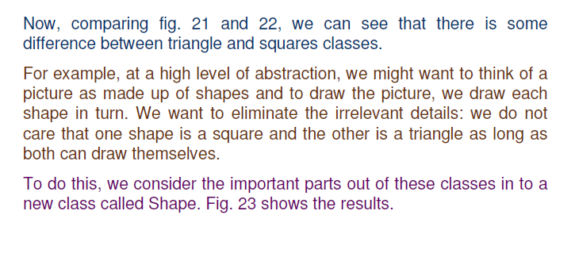

Slide 60
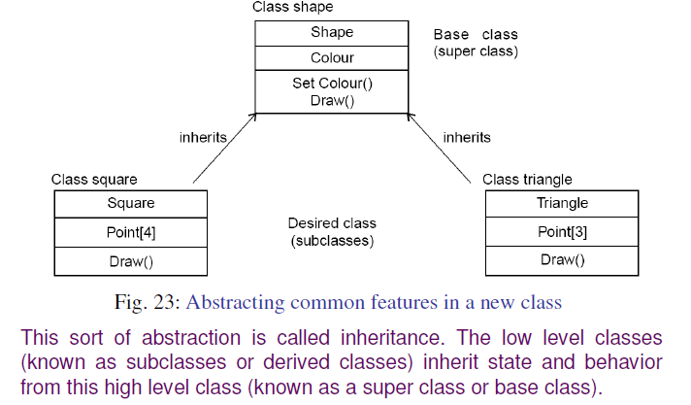

Slide 61
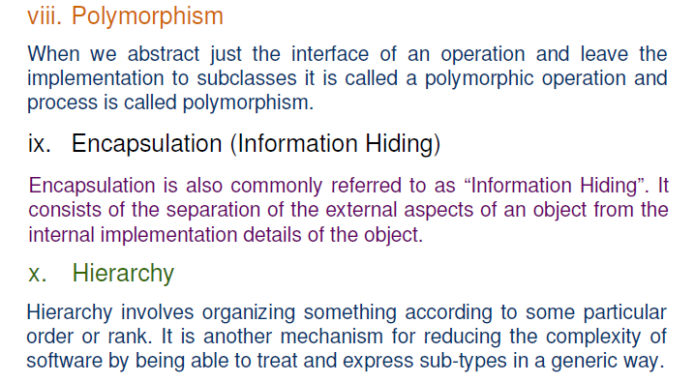

Slide 62


Slide 63



Slide 64

The Unified Modeling Language (UML) is a general-purpose, developmental, modeling language in the field of software engineering, that is intended to provide a standard way to visualize the design of a system.

Slide 65


Slide 66


Slide 67


Slide 68
Activity Diagram Example - Student Enrollment:
This UML activity diagram example describes a process for student enrollment in a university as follows:
An applicant wants to enroll in the university.
The applicant hands a filled out copy of Enrollment Form.
The registrar inspects the forms.
The registrar determines that the forms have been filled out properly.
The registrar informs student to attend in university overview presentation.
The registrar helps the student to enroll in seminars.
The registrar asks the student to pay for the initial tuition.

Slide 69


Slide 70


Slide 71


Slide 72


Slide 73



Slide 74

Notes:
Interface-webpages
The programs that we write for executing the actions
The database

Slide 75


Slide 76


Slide 77


Slide 78


Slide 79


Slide 80


Slide 81
Class Diagram:
Class diagram is a static structural diagram.
It represents the static view of an application.
Class diagram is not only used for visualizing, describing, and documenting different aspects of a system but also for constructing executable code of the software application.
Class diagram describes the attributes and operations of a class and also the constraints imposed on the system.
The class diagrams are widely used in the modeling of object oriented systems because they can be mapped directly with object oriented languages.

Slide 82
The purpose of the class diagram can be summarized as:
Analysis and design of the static view of an application.
Describe responsibilities of a system.
Base for component and deployment diagrams.
Forward and reverse engineering
Notes:
Forward engineering: Developing a new software
Reverse engineering: Whenever we are trying to get or understand the models or layout of the developed software.

Slide 83

Notes:
Generalization: represents relationships between the classes themselves.
Association: represents relationships between instances of the classes.
Aggregation eg.: Delete a class and the student will still exist

Slide 84


Slide 85


Slide 86


Slide 87

vi. Draw component and deployment diagram
Component diagrams are used to describe the components such as files, executables, libraries, etc. and deployment diagrams shows how they are deployed in hardware.
Notes:
Component- dll, executable program, an applet, a file, package, library, an application

Slide 88


Slide 89
Some Important Aspects of Implementation:
Reuse
Configuration Management
Host-target development

Slide 90
Reuse:
Software reuse is possible at a number of different levels:
1. The abstraction level: At this level, you don’t reuse software directly but rather use knowledge of successful abstractions in the design of your software. Design patterns and architectural patterns are ways of representing abstract knowledge for reuse.
2. The object level :At this level, you directly reuse objects from a library rather than writing the code yourself. To implement this type of reuse, you have to find appropriate libraries and discover if the objects and methods offer the functionality that you need. For example, if you need to process mail messages in a Java program, you may use objects and methods from a JavaMail library.

Slide 91
3. The component level: Components are collections of objects and object classes that operate together to provide related functions and services. You often have to adapt and extend the component by adding some code of your own. An example of component-level reuse is where you build your user interface using a framework. This is a set of general object classes that implement event handling, display management, etc. You add connections to the data to be displayed and write code to define specific display details such as screen layout and colors.

Slide 92
4. The system level: At this level, you reuse entire application systems. This usually involves some kind of configuration of these systems. This may be done by adding and modifying code (if you are reusing a software product line) or by using the system’s own configuration interface. Most commercial systems are now built in this way where generic COTS (commercial off-the-shelf) systems are adapted and reused. Sometimes this approach may involve reusing several different systems and integrating these to create a new system.

Slide 93
Configuration Management:
Configuration management is the name given to the general process of managing a changed software system.
The aim of configuration management is to support system integration process so that all developers cam access the project code and documents in a controlled way, find out what changes have been made, and compile and link components to create a system.

Slide 94
Three fundamental configuration management activities:
1. Version management, where support is provided to keep track of the different versions of software components. Version management systems include facilities to coordinate development by several programmers. They stop one developer overwriting code that has been submitted to the system by someone else.
2. System integration, where support is provided to help developers define what versions of components are used to create each version of a system. This description is then used to build a system automatically by compiling and linking the required components.

Slide 95
3. Problem tracking, where support is provided to allow users to report bugs and other problems, and to allow all developers to see who is working on these problems and when they are fixed.

Slide 96
Comprehensive change management system- ClearCase
Or Use Separate tools such as – Subversion for Version management, GNU build system for System Integration, Bugzilla to repot bugs and other issues and to keep track of whether or not these have been fixed.

Slide 97
Host-Target development:
For embedded systems, where the target is usually a single computer.
However, for distributed systems, you need to decide on the specific platforms where the components will be deployed. Issues that you have to consider in making this decision are:
1. The hardware and software requirements of a component: If a component is designed for a specific hardware architecture, or relies on some other software system, it must obviously be deployed on a platform that provides the required hardware and software support.
2. The availability requirements of the system :High-availability systems may require components to be deployed on more than one platform. This means that, in the event of platform failure, an alternative implementation of the component is available.

Slide 98
3. Component communications: If there is a high level of communications traffic between components, it usually makes sense to deploy them on the same platform or on platforms that are physically close to one other. This reduces communications latency, the delay between the time a message is sent by one component and received by another.

